Slide 1

FINANCE MANAGEMENT SYSTEM – LTF (Let’s Talk Finance)
FINAL PROJECT- KNOWLEDGE & EXPERT SYSTEM
Group Members: Dwij Dua (100850599)
Megha Garg (100851223)
Minu Ahlawat (100810763)
Taxil Savani (100847072)

Slide 2
TABLE OF CONTENTS
01.
02.
03.
OVERVIEW OF THE PROBLEM
SOLUTION: EXPERT SYSTEM
SOURCES AND ACQUISITION
05.
06.
07.
deMO
User Interface
Engineering
04.
design
08.
09.
IMPLEMENTATION
GROUP MEMBER TASKS

Slide 3

OVERVIEW
Even the most financially savvy person may become confused or have limited vision due to the overwhelming and ongoing nature of managing personal finances. This application is going to help you to target the right balance between what you really need and what you really want. The output will be fruitful financial advice based on the inputs given for age, income, expenditure on vacations, entertainment, grocery, electricity bills and investment made in stocks, insurance and other financial assets. Not only this app provides a better user interface but also aids in striking financial aims and investment decisions.

Slide 4
SPECIFICS OF LTF
Managing Income & Cash Flow
The first three items on the list all relate to one another in the same fundamental way: having a thorough and detailed system by which you can track and understand your income and expenses enables you to make the most of what you earn and, in turn, generates capital that can be used to address other concerns and position you for a financially secure future.
Managing Financial Security and Growth
A few of the other crucial categories included in the list above have to do in one way or another with monetary growth and security, specifically insurance and investing.
Establishing Liquid Savings
Another valuable point is that you should have some of the money you set aside for development or savings on hand in case of necessity.

Slide 5

SOLUTION: EXPERT SYSTEM
To make the most of your resources in both daily living and future planning, our solution to this problem simply entails analyzing your financial condition.
Income, Examining your income to determine how much you will need to set aside for taxes, basic necessities, etc.
Cash Flow To maximize your income, control your spending and set plans ahead of time.
Capital. Having leftover cash as a result of managing cash flow.
Family Security, Recognizing the importance of considering how to support and protect your family (through insurance and other means).
Investment, making a plan to aid in the long-term growth of your capital.
Standard of Living, Ensuring the highest level of comfort possible as a result of wise financial preparation.
Financial Understanding, Utilizing your personal choices and outcomes to better comprehend what functions in your financial management plan.
Assets, Acquiring valuable assets (or investments) with low risk and limited liability.
Savings, Keeping a reserve of emergency funds on hand or in highly liquid investments.
Ongoing Advice, Developing a relationship with a financial planning professional to position yourself for sound judgment.

Slide 6
benefits OF LTF
USER FRIENDLY INTERFACE
EFFICIENT FINANCE
BETTER ACCOUNTING
IMPROVED FINANCIAL DECISION
EASE IN TARGETING FINANCIAL AIMS
COMMIT FEWER MISTAKES

Slide 7
sources AND ACQUISITIONS
Meetings & Knowledge Development
Data collection from banks & Financial Firms
Online & OFFLINE Data Scrapping from websites
Meeting with Financial Advisors
Assessment of Financial Reports
Banks – Balance Sheets, Income statement, Cash Flow Statements
Data from Bloomberg, Factset, ICE etc.
Trip Planning Websites
Electricity & Grocery Bills
Entertainment Spending Reports
Investment Data

Slide 8


DESIGN
Junior ( Age < 32 )
Age
Senior ( Age > = 32 )

Slide 9
DESIGN
Income
Low
(Income<2000)
Upper
(Income > 5500)
Mid
(2000 < Income < 5500)

Slide 10
DESIGN
1
Green Zone
( Safe )
SPEND
2
Red Zone
( Exceeded Usual limit )

Slide 11
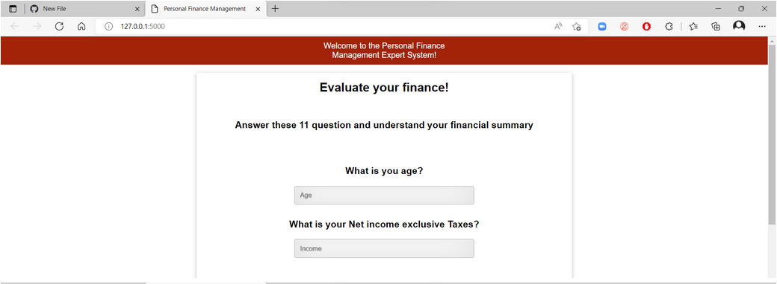
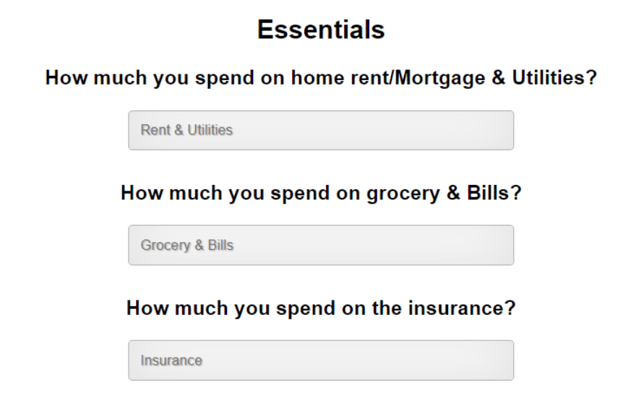
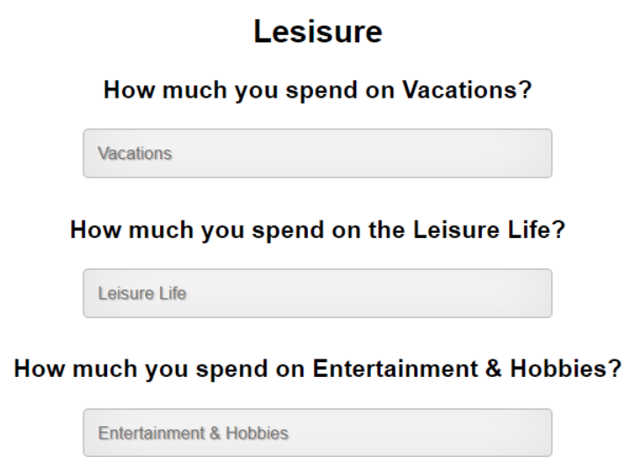
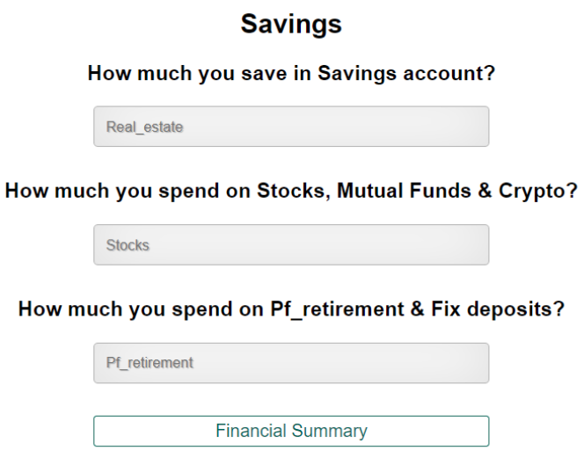
DEMO
1
2
3
4

Slide 12
User interface
The UI of LTF consists of 3 sections related with Essentials, Leisure and Savings with 11 input questions. After putting all necessary inputs, user can click on a button ‘Financial Summary’, provided on the bottom of the page and can view a detailed financial summary indicating all the pros, cons and advises on the current financial plan.

Slide 13
IMPLEMENTATION
HTML/CSS: Used at front end and styling of webpage.
Python: Main logic and back-end implementation is done in python.
Flask: Flask is a small and lightweight Python web framework that provides useful tools and features that make creating web applications in Python easier.
Jinja2: It is used to produce markup languages such as HTML, XML, and others that are delivered to the user via an HTTP request.
Visual Studio Code: An incredibly quick source code editor is included in Visual Studio Code, makes it ideal for regular use. With hundreds of languages supported, VS Code makes it easy for you to get started right away and be productive with features like syntax highlighting, bracket matching, auto-indentation, box selection, snippets, and more.

Slide 14
GROUP MEMBER TASKS
Information gathering
DESIGN
PRESENTATION
IMPLEMENTATION
MINU AHLAWAT & MEGHA GARG
TAXIL SAVANI & DWIJ DUA
MINU AHLAWAT & MEGHA GARG
DWIJ DUA & TAXIL SAVANI

Slide 15
THANK YOU!

